Slide 1






Virtual Assistant For Citizens, Goodpy
(2nd UNDP-ACSH Capacity Building Workshop, 2024)
Ministry of the Interior and Safety
Notes:
Good morning afternoon everyone.
I am Namgung-Jiyoon. I’m with the Public Service Integration Division of the Ministry of the Interior and Safety, or MOIS.
It is my honor and privilege to be here in Cambodia to provide an introduction on one of the signature administrative services of my country, the Virtual Assistant Service, or Virtual Assistant.
As a staff member behind the service, I feel a renewed sense of responsibility to make Virtual Assistant even better.
Now, I will begin this presentation by explaining what the Virtual Assistant Service is.

Slide 2

Table of Contents
1. What is the Virtual Assistant? ----------------------------------------- 3
2. Virtual Assistant : current Status ------------------------------------- 4
3. Virtual Assistant inquiry Services -------------------------------- 7
4. Main Virtual Assistant inquiry Services ---------------------------- 18
5. Improvement of Virtual Assistant Service and Future Plans ---- 26
[GoodPy] : GoodPy is a character designed to make the Virtual Assistant feel approachable and close to people’s lives.
GoodPy is a short for "I will be your virtual assistant“ in Korean, or “Good Biseo,” which means “good assistant.”
Notes:
In today’s presentation, I will discuss the following topics.
In Chapter 1, I will explain what the National Assistant Service is.
In Chapter 2, I will outline the current operational status of the National Assistant Service.
In Chapter 3, I will explain inquiry services that includes AI technology.
In Chapter 4, I will go over some cases regarding the key Virtual Assistant inquiry Services.
In Chapter 5, I will describe the future development of Virtual Assistant service and its future plans,
followed by a Q&A session to answer any questions you may have about the Virtual Assistant Service.
By the way, the image you see on the screen is the character for the Virtual Assistant Service,
selected among nationwide submissions.
It’s name is GoodPy. It is a short for “Good Biseo,” which means “Good Secretary.” We chose this name to make the Virtual Assistant Service feel more approachable and close to people’s life.

Slide 3
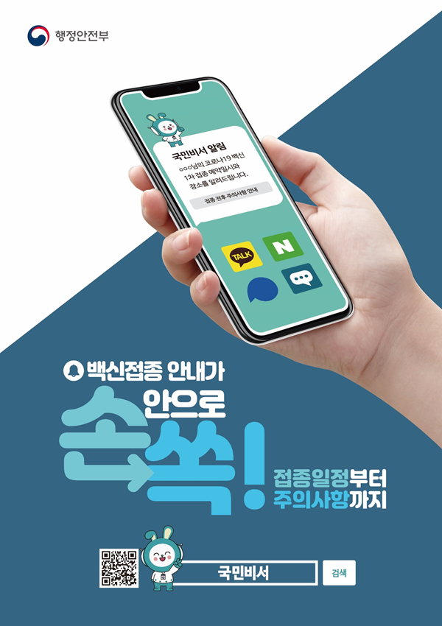

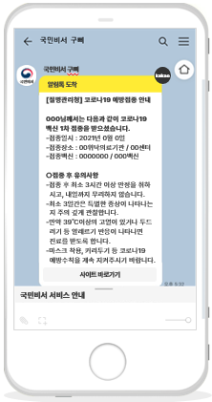




1. What is the Virtual Assistant?
Electronic Notices
Notifications
Inquiry
What is the Virtual Assistant Service? It consists of two services:
App of
Your
Choice
A notification service that provides users with timely and personalized day-
to-day or administrative information using private sector apps of their choice
An inquiry service that supports 24/7 inquiry via chatbot
Day to Day/Administrative Information
Convenient
Mobile Services
Notification Service
Inquiry Service
Public Administrative Institutions
(Information Providers)
Linked Institutions
Virtual
Assistant
Notification/
Inquiry
Electronic Notice
Convergent
Services
Shared
Platforms
Personalized
Notes:
The Virtual Assistant Service was born out of the question, “How can we provide help people access various administrative information easily and conveniently using apps that people frequently use?"
The Virtual Assistant serves as an "online assistant" which the government uses to proactively provides citizens with the administrative information they need in personalized services.
The Virtual Assistant Service is mainly composed of the Notification Service, which notifies users of timely day-to-day and administrative information using the apps of their choice, and the Inquiry Service, which provides 24/7 inquiry through chatbots and AI speakers.
The Virtual Assistant Notification Service notifies people of personalized life administrative information such as health checkup dates, customs clearance information for direct purchases from overseas, and traffic fines in advance through private sector apps used by citizens. People can use the service to make payments via bank transfer if necessary.
The government provides a wide range of administrative information, such as benefits information and notifications. However, it is delivered in different ways depending on the institution or the service involved such as mail, email, and text message. The National Assistant Service allows users to choose which services that they want to be notified, using the app they prefer.
The Inquiry Service allows users to use chatbots to ask questions about administrative services such as civil complaint inquiry, e-customs clearance (overseas direct purchase), and natural recreational forests, or use
AI speakers to receive voice notification on civil complaint services.
Since only The Inquiry service uses AI technology among the notification and Inquiry services, we will explain the Inquiry service in more detail in CHAPTER 3.

Slide 4
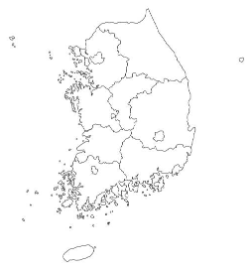

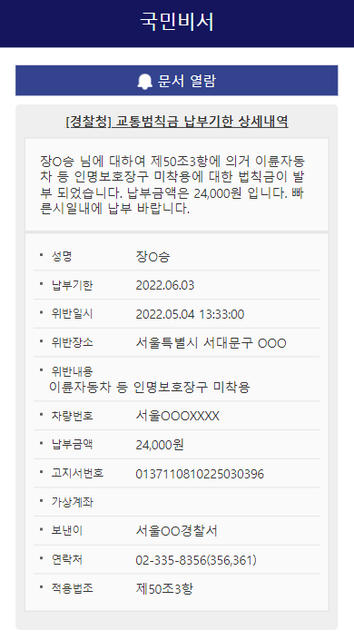
2. Virtual Assistant: Current Status
As of June 24
Built and launched the services
2022~
2023~
[Virtual Assistant]
Applicants: 16.8 million
Notifications sent: 826.56 million
Inquiry case : 653 milion
(including vaccination notifications)
Mar. 2021
2021~
2020
Virtual Assistant
Development Project
Phase 3
2023
Expanded the Virtual
Assistant service
Launched
Virtual Assistant
Service
Virtual Assistant
Development Project
Phase 2-2
Virtual Assistant
Development Project
Phase 1
(Phase 2-1)
2024: Expanded and improved on Virtual Assistant
MOIS
MOIS
MOIS
MOIS
Develop intelligent
virtual assistant
Built Complaint
365
Develop intelligent virtual assistant
May 2024 to Dec. 2024
Sep. 2021 to Apr. 2022
Virtual Assistant Development, Phase 3
MOIS/NIA
Notifications
Inquiry
COVID-19
vaccinations
May 2022 to Dec. 2022
2023: expand and innovate services
Jul. 2020 to Dec. 2021
Notification Services
Notification service
Jul. 2020 to Feb. 2021
Notification
Services
May 2023 to Dec. 2023
Expand services
11 types
2 types
Expand services
Expand channels
New services
Inquiry
Services
Build complete one-stop shop services
Expand services
Integrate services
Expand notification channels
Expand services
Mar. 2021 to May. 2021
Notifications
Notices
Build
Link
Regional services
Support e-bill delivery
Apply different
UI/UX for different chatbot usage types
Collect chatbot feedback
Upgrade service features
Develop and improve
on features
Convergent Services
1 or more types
Notifications:
13 types
Inquiry:
13 types
Expand services
Expand channels
New services
Inquiry services
Expand private
sector app
channels
Virtual Assistant
user organization
Upgrade the shared foundation
Expand notification channels
Short-form
bills
Build verification environment
Link shared foundations
Enhance the operation system
Expand Government24
notifications
Pilot application of
Any-ID
Notifications → Inquiries
Convergent
Service
link
Link with Government Digital Wallet
Notes:
2. Virtual Assistant Status and history:
- Launched the Intelligent Virtual Assistant Development Project in 2020, launched the service in March 2021, and currently operates more than 70 notification services as of '24
- In particular, the 'COVID-19 Vaccination' notification service in 2021 gained traction and response from the entire nation, resulting in a sharp increase in users.
- We have added new services and improved features every year (*This year, we added 22 notification services and 13 inquiry services)
(As of Oct. 2024), Virtual Assistant applicants surpassed 16.8 million, and the cumulative number of Virtual Assistant Notifications reached 826.56 million, the cumulative number of Virtual Assistant inquiry case reached 653 million,
※ It has become the representative administrative service of the government used by more than one out of every three people in South Korea (* Korea’s population in 2023: 51.33 million).

Slide 5
2. Virtual Assistant : Current Status
Notifications Services (as of Dec. 31, 2023)
Inquiry Services (as of Dec. 31, 2023)
Notifications sent : 709.23million
Chatbot inquiries: 5.59million
Service Expansion Status
Status by Area
Service Expansion Status
Status by Area
56services
67services
New (13 services)
42services
45services
Living, welfare, and local taxes (13 services)
Legal notifications (notices) (13 services)
19%
9%
Leisure & health (7 services)
29%
Complaint (6 services)
10%
Industry, patent, and commerce (7 services)
11%
27 services
Continuing education/tests (7 services)
22 services
15%
Automotive/transportation (7 services)
19%
10%
Housing and transportation (5 services)
8 services
Taxes, notices and pensions (5 services)
11 services
Crime and safety (5 services)
7%
11%
Education, tuition, and volunteer (5 services)
3%
8%
Education, employment, and military service (5 services)
11%
16%
Health and housing (4 services)
5%
8%
Dec. 2023
Guides (3 services)
6%
Dec. 2023
Others (3 services)
2021
2022
2023
Notification of my information search (2 services)
3%
2021
2022
2023
* Guide services and terminated services not included
Resident registration (2 services)
* Based on 67 services
* Linked services included, terminated services not included
* Based on 45 services
* Others: Civil Complaint Information, Integrated Government Call 110, Practical Law service
Top 5 Delivery Status
Service Satisfaction
Top 5 Delivery Status
Service Satisfaction
1
Physical checkup (including cancer checkup)
45.19 million
1%
1
Super Rapid Transit (SRT)
1.07 million
2
Very satisfied
42%
1%
2
Very satisfied
Government24 Complaints
31.55 million
Satisfied
E-clearance
0.52 million
20%
3
eCommerce goods clearance history
3
Civil complaint guide
Satisfied
76%
16.44 million
Neither satisfied nor dissatisfied
0.3 million
Neither satisfied nor dissatisfied
2%
4
Traffic ticket payment deadlines
8.49 million
Dissatisfied (0%)
4
Government employee pensions
0.24 million
Dissatisfied (0%)
1%
5
Work Incentive Application Guide
Very dissatisfied
56%
5
Natural Recreational Forests
Very dissatisfied
1%
4.9 million
0.15 million
* Cumulative number of notifications
(Mar. 28, 2021 to Dec. 31, 2023), unit: no, of notifications
* 2H 2023 satisfaction survey with notification users (136,000)
* Chatbot excluded, no. of dialogues
* Ongoing satisfaction survey (Jan. 2022 to Dec. 2023),
7,124 participants
* Guide services (190.42 million) and vaccine/at-home care/
health status check notifications (552.81 million) excluded.
Notes:
In just over three years since its launch in March 2021, the Virtual Assistant Service has achieved a stellar growth, surpassing 16 million Notification Service members.

Slide 6


3. Virtual Assistant Inquiry Services
▪ What is Virtual Assistant Inquiry Services ?
The National Secretary Consultation Service is an AI-based service that provides
24-hour support for citizens' inquiries about administrative and public services
▪ What technology is used?
Notes:
국민비서 상담서비스는 국민이 행정 및 공공서비스에 대한 문의를 24시간 지원하는 AI기반 서비스입니다.
이 서비스는 자연어처리(NLP)기술을 활용하여 사용자의 질문을 이해하고 적절한 답변을 제공합니다.
특히 구글에서 개발한 BERT모델이 핵심 기술로 활용되고 있습니다.
The National Secretary Consultation Service is an AI-based service that provides 24-hour support for citizens' inquiries about administrative and public services.This service uses (NLP) technology to understand the user's question and provide an appropriate answer.In particular, the BERT model developed by Google is used as the core technology.

Slide 7


3. Virtual Assistant Inquiry Services
NLP(Natual Language Processing)
AI that uses information and communication technology to understand, generate,
and analyze human language
Delivering
a message
Message
Encoding
Receiving a
message
Message
Decoding
NLP
Notes:
Let me briefly explain NLP and BERT.
NLP refers to the totality of technologies that enable machines to understand, generate, and interact with human language.
As you can see on the screen, the process of delivering, enconding, receiving and decoding messages so that computers can understand human language takes place.

Slide 8

3. Virtual Assistant Inquiry Services
BERT(Biodirectional Encoder Representations from Transformers)
bert is a natural language processing model released by Google in 2018.
It is a transformer-based model designed to understand context in both directions.
Notes:
bert is a natural language processing model released by Google in 2018. It is a transformer-based model designed to understand context in both directions.
bert is pre-trained on a large amount of text data. Then, the pre-trained bert is transferred to a specific task.

Slide 9
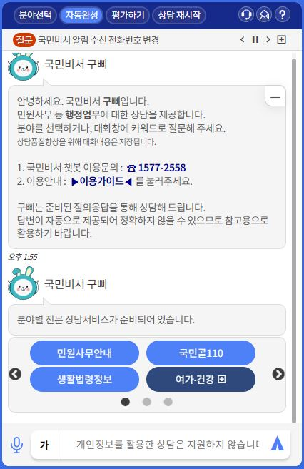
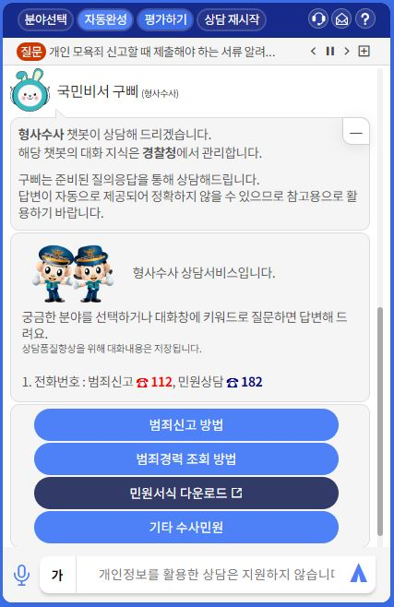
3. Virtual Assistant Inquiry Services
Virtual assistant Inquiry Services consists of a common chatbot and an service chatbot.
Common Chatbot
Service chatbots
Print out a common welcome greeting
Common announcements and questions
Branch initialization status for all institutional chatbots
Print a welcome and basic instructions for each service
Present information coverage by service as a menu
Branching out to other chatbots
Notes:
이제 이 기술들을 이용한 국민비서 상담서비스의 작동방식을 설명드리겠습니다.
Now, I will explain how virtual assistna inquiry service using these technologies works.
Virtual assistant inquriy services consists of a common chatbot and an service chatbot
The common chatbot is the initial screen of the National Secretary Consultation Service, which displays a welcome greeting and a guide menu.
And when a user decides on one of the various consultation services by selecting a menu or entering a word, they are directed to the corresponding chatbot.

Slide 10

3. Virtual Assistant Inquiry Services
Civil affairs office guide
Common Chatbot
service1
living law informtion
service2
Health and welfare
service3
10
Notes:
위 그림과 같이 common chatbot에서 각 서비스에 맞는 service chatbot으로 분기되게 됩니다.
상담 서비스에는 living law information, civil affairs office guide 등 총 58종이 있으며, 사용자의 질문이나 메뉴 선택을 통해 해당 서비스에 맞는 챗봇으로 분기되게 됩니다.
As shown in the figure above, the common chatbot branches out to the service chatbot that is suitable for each service.There are a total of 58 types of consultation services, including living law information and civil affairs office guide, and the chatbot will branch off to the right service for the user's question or menu selection.

Slide 11
3. Virtual Assistant Inquiry Services
The procedure for branching chatbots for the virtual assistant inquiry services is as follows.
Branch keywords
BERT
Provide services based on whether the user query contains service branch keywords.
Provide answers to applicable user queries when selecting service.
Branching based on the BERT learning model
Explore answerable chatbots
Instantly connect to the answer if there is a single chatbot that can answer / Recommend a shortlist if there are multiple chatbots
Provide answers to applicable user queries when selecting an service
Notes:
Viutual assistnat inquiry Service uses the BERT model to interpret the user's language.
사용자 질의 내 분기 키워드에 따라 해당 서비스 챗봇으로 연결됩니다.이때 bert 학습 모델 기반으로 분기하게 되며, 사용자의 키워드를 보고 답변 가능한 서비스 챗봇을 탐색하고, 답변 가능 챗봇이 1개일 경우 해당 챗봇으로 즉시 연결하고, 여러개일 경우 후보 목록을 추천합니다.
The user's query is connected to the relevant service chatbot according to the keywords in the quarter.At this time, the user is directed to the service chatbot based on the bert learning model. The service chatbot that can answer the user's keywords is searched, and if there is only one chatbot that can answer, the user is immediately directed to that chatbot, and if there are multiple chatbots that can answer, a list of candidates is recommended.

Slide 12
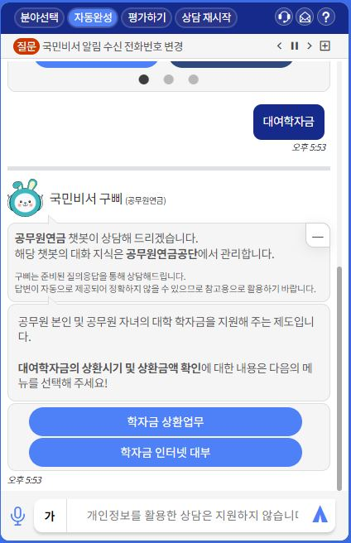
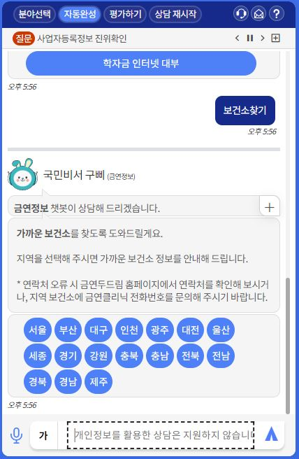
3. Virtual Assistant Inquiry Services
The procedure for branching chatbots for virtual assistant inquiry Service is as follows.
The procedure for branching chatbots
Public employee pensions
Smoking cessation information
Common Chatbot
Notes:
화면과 같이 키워드에 따라 분기하게 됩니다.
As shown in the screen, it is divided according to the keyword.

Slide 13
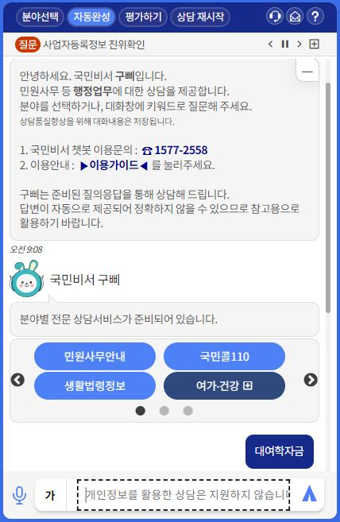
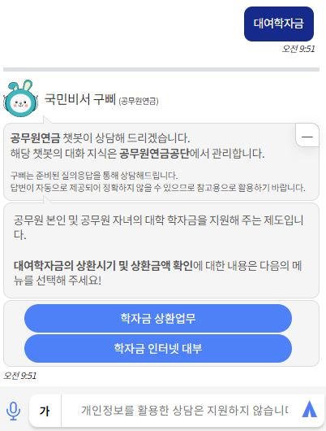
3. Virtual Assistant Inquiry Services
Provides a list of chatbot services based on whether they include keywords for each quarter of the organization.
Branch keywords
Notes:
Provides a list of chatbot services based on whether they include keywords for each quarter of the organization

Slide 14
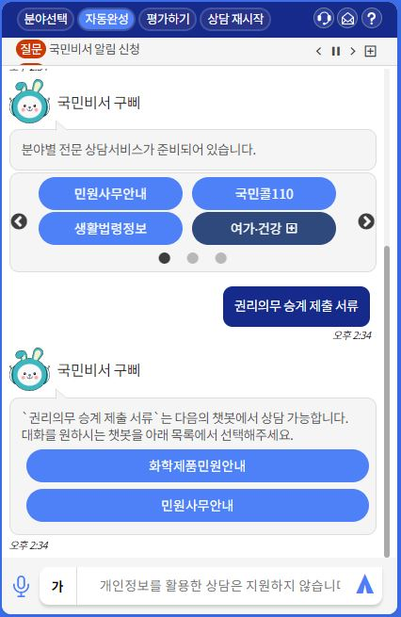
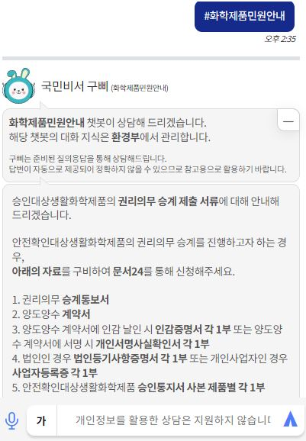
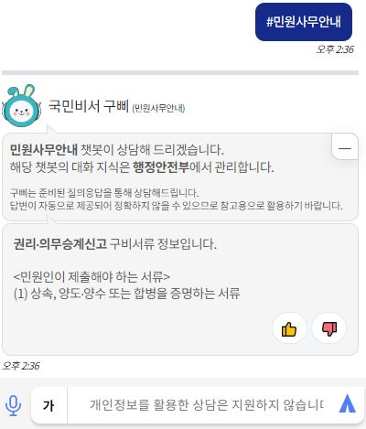

3. Virtual Assistant Inquiry Services
Recommend a list of chatbot services whose queries are included in the BERT training model.
BERT
Notes:
Recommend a list of chatbot services whose queries are included in the BERT training model.

Slide 15


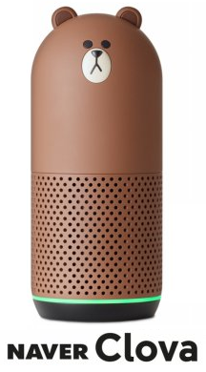





3. Virtual Assistant Inquiry Services
AI Speaker Channels
Filtering the knowledge base for voice service usage
Chatbot Engine
AI speaker services (4 types)
Gateways
Civil Affairs
Instructions
Voice data processing
API Wrapper
KT
Naver
SKT
Kakao
Question
Chatbots
Branching
AI speaker channel-specific adapters
...
Preprocessing of channel-specific format data
Text
Criminal Investigations
Using mobile apps (3 types)
Post-processing for voice speaker utterances
E-customs clearance
Clova
Phone
Heikakao
Answer
North Korean Refugee Resettlement Assistance
Text
...
AI SPEAKERS
- STT : Converting voice questions into text, queries.
- TTS : Convert text answers to voice and deliver.
Image
Knowledge base filters
URL
Consular complaints
Applying HTML Filters
(tags, tables, images, special characters, paths)
File
Intellectual property
Vehicle emissions365
Notes:
다음은 AI스피커입니다.
네이버 클로버, 카카오 등 AI 스피커를 이용해 국민비서 상담 서비스를 이용할 수 있습니다.
이때 STT와 TTS 기술을 이용해 음성과 텍스트간 변환을 하게 됩니다.
AI스피커 채널을 통해 음성이 전달되고, 음성 데이터가 처리된 후 챗봇 엔진과 소통하게 됩니다.
Next is the AI speaker.You can use AI speakers such as NAVER Clover and Kakao to access the National Secretary Consultation Service.In this case, speech-to-text and text-to-speech technologies are used to convert between voice and text.Voice is transmitted through the AI speaker channel, and after the voice data is processed, it communicates with the chatbot engine.

Slide 16
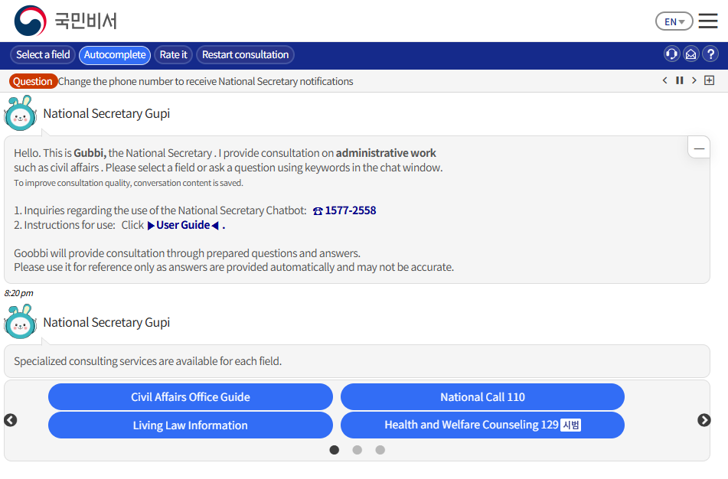
4. Main Virtual Assistant Inquiry Services
Notes:
이제 국민비서 상담 서비스 예시를 보여드리겠습니다.
다음 화면은 국민비서 상담 서비스 예시화면입니다.
Now, I will show you an example of the National Secretary Consultation Service.The following screen is an example of the National Secretary Consultation Service.
The National Secretary can provide support in multiple languages.This is the screen when English is selected.
you can select the service you want or search for it.

Slide 17
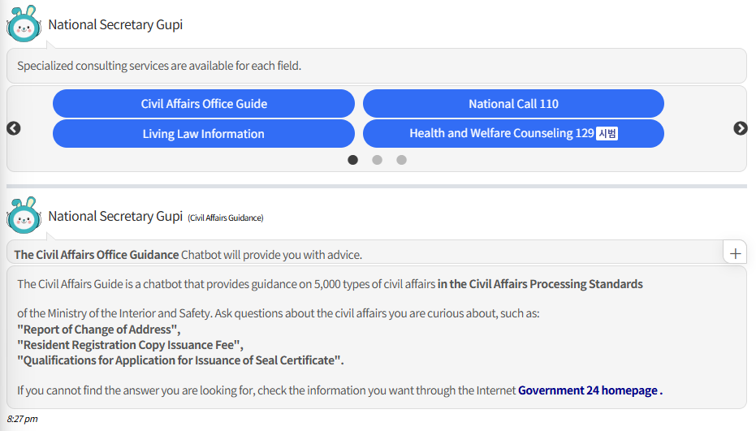
4. Main Virtual Assistant Inquiry Services
Notes:
‘civil affairs office guide’를 선택했을때는 다음과 같은 화면이 출력됩니다.
구삐는 더 자세한 상담을 위한 질의를 추천해주게 됩니다.
When you select 'civil affairs office guide', the following screen will be displayed. gupi will recommend a question for a more detailed consultation.

Slide 18
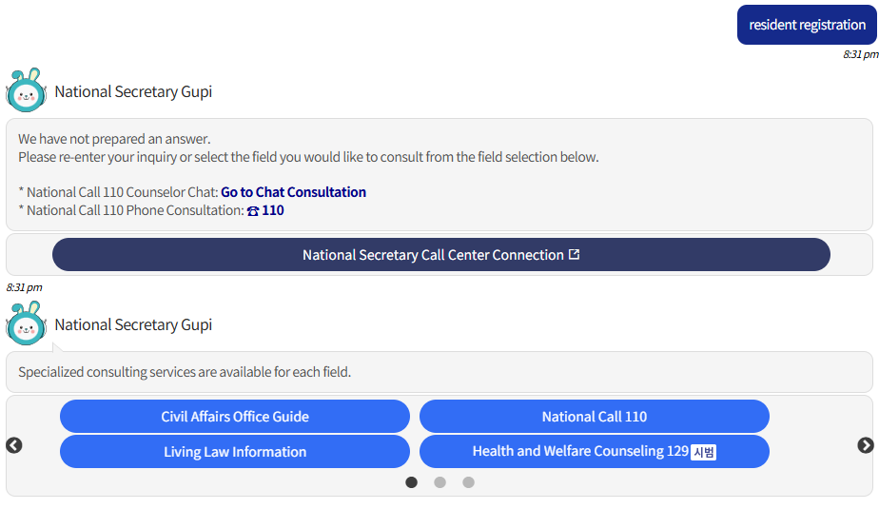
4. Main Virtual Assistant Inquiry Services
Notes:
그리고 해당 단어를 해석할 수 없는 경우, 국민비서 콜센터로 연결해주는 화면이 뜹니다.
국민비서는 콜센터를 운영하고 있으며, 상담사가 국민비서에 관련된 여러가지 사항을 답변해드리고 있습니다.
And if the word cannot be interpreted, a screen will appear that connects you to the National Secretary Call Center.The National Secretary operates a call center, and the counselors answer various questions related to the National Secretary.

Slide 19
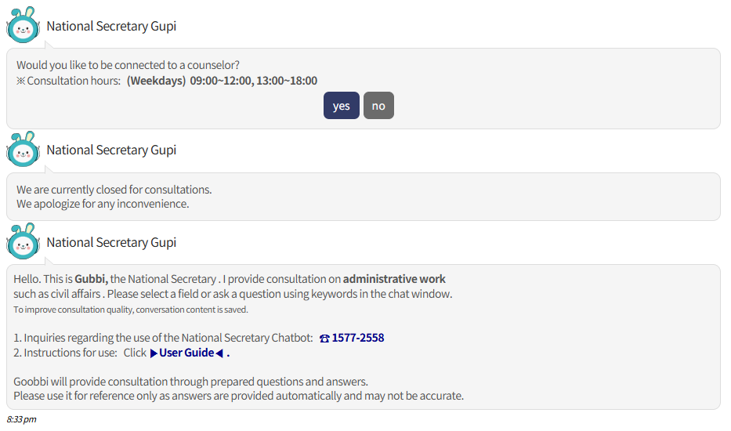
4. Main Virtual Assistant Inquiry Services
Notes:
그리고 콜센터 연결 버튼을 클릭하면 yes,no 버튼이 화면에 나타나고, 상담 가능시간이 아닐경우, 대화 초기창으로 돌아가게 됩니다.
And when you click the call center connection button, the yes and no buttons will appear on the screen, and if the available time is not available, you will be returned to the initial window of the conversation.

Slide 20

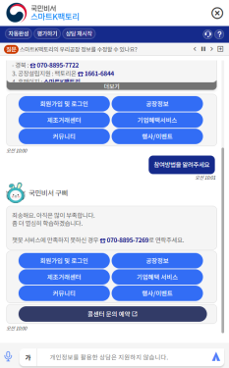
4. Main Virtual Assistant Inquiry Services
Call Center Inquiry Service (Smart K Factory)
Call Center
inquiry
People (users)
Virtual Assistant Convergent Service types
Institution call center
Virtual Assistant
Inquiry Service
Inquiry
No response→ Call Center booking
Service
representative
Provides
conversation
history
Send the National Assistant inquiry history to the institution's call center
service representative
Speed up customer service processing and increase satisfaction
by providing conversation history!
Notes:
다음은 콜센터 사례 중 하나입니다.
Here is one example of a call center.
- During a Smart K Factory chatbot inquiry service, if the chatbot does not or cannot response to an inquiry, this feature refers the user to a call center service representative.
- In such cases, the Virtual Assistant delivers the history of previous conversations to the institution's service representative to help them quickly understand the user's intention and minimize inconvenience.
* Smart K Factory : A manufacturing and transaction support platform designed to make it easy to find the manufacturing plants of the user’s choice across the country and match the desired manufacturing plants.

Slide 21
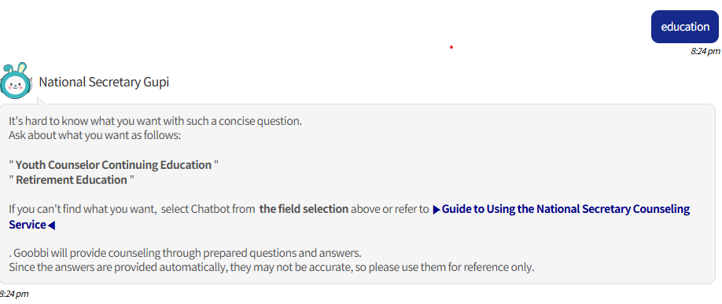
4. Main Virtual Assistant Inquiry Services
Notes:
In addition, if a word is difficult to understand with just one word, Gupie recommends a phrase that includes the word.

Slide 22
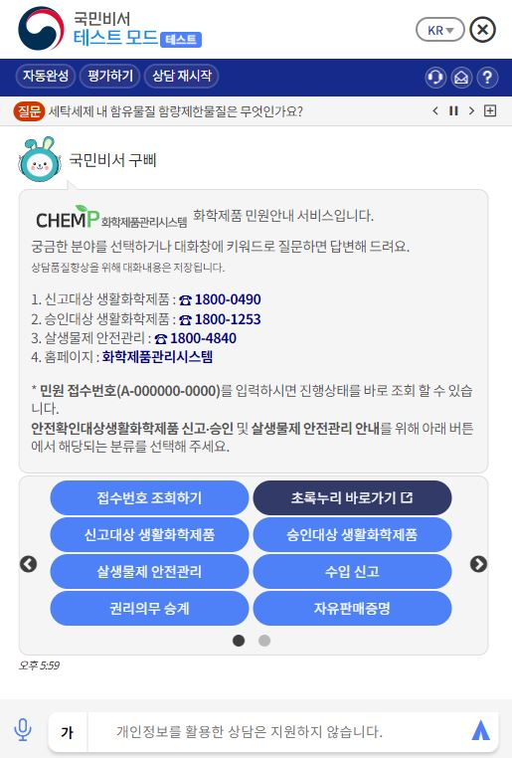
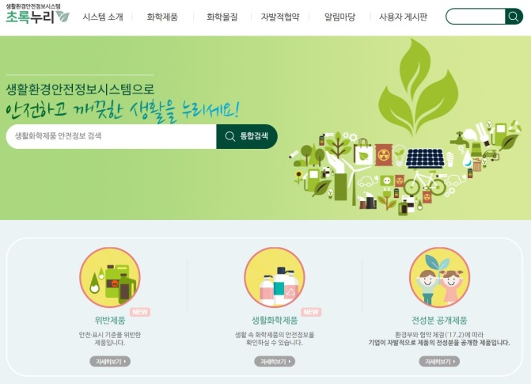
4. Main Virtual Assistant Inquiry Services
Notes:
In addition, a screen that links to the relevant site from the National Secretary will appear, and clicking on it will take you to the site.

Slide 23
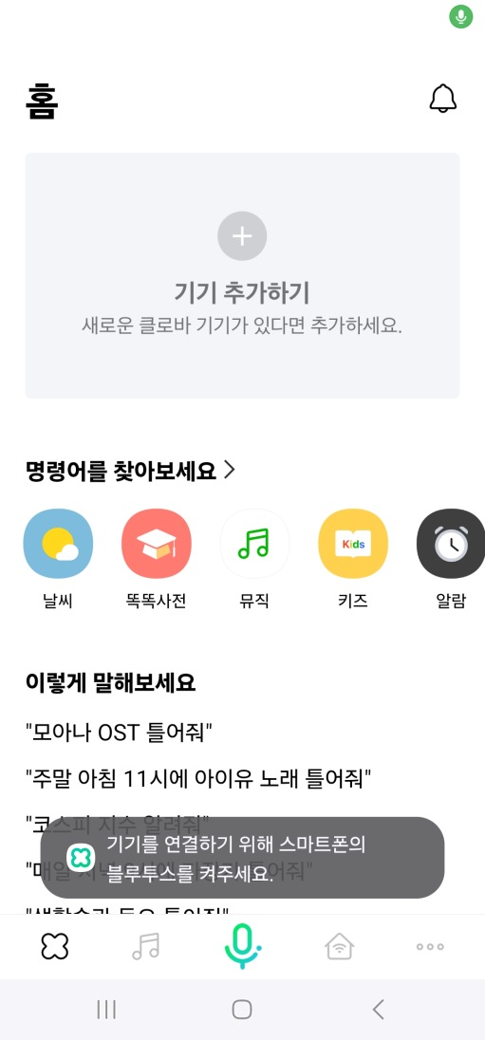
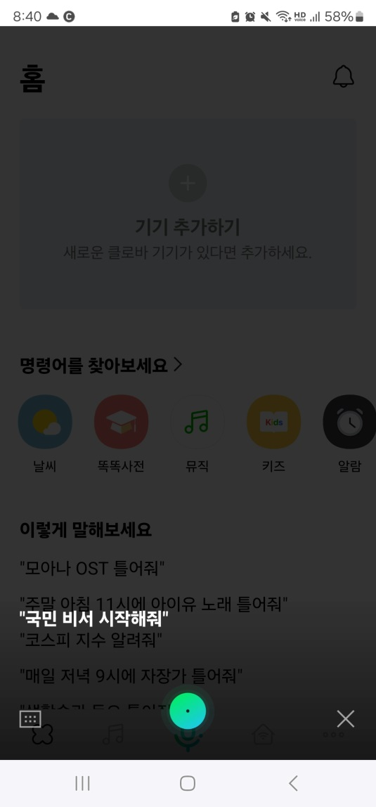
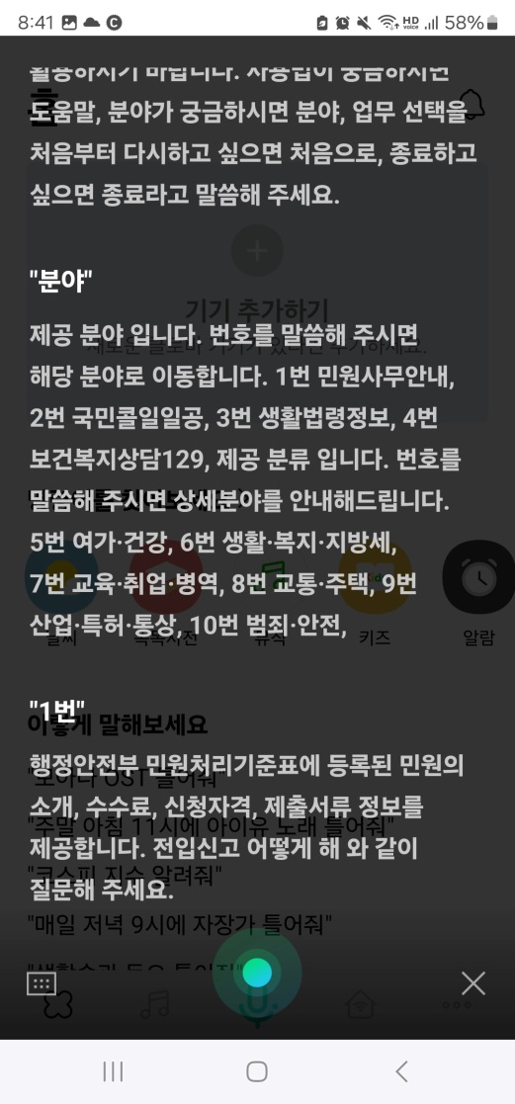
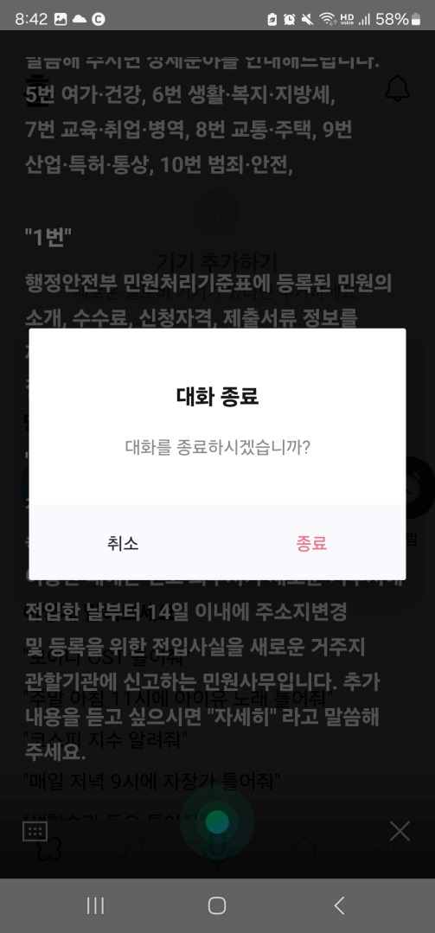
4. Main Virtual Assistant Inquiry Services
Notes:
다음은 ai스피커 예시를 보여드리겠습니다.
국민비서 상담서비스는 ai스피커 4종과 앱 3종 사용 가능합니다.
위 예시는 네이버 클로버앱을 사용했습니다.
클로버앱에 접속하여 마이크 버튼을 클릭한 후 국민비서 시작해줘 라는 문장을 말하면 국민비서 상담서비스가 시작됩니다.
이후 국민비서가 몇가지 질의를 추천해주므로, 여기서 선택하거나, 또는 본인이 관심있는 분야에 대한 단어를 말하면 상담이 가능합니다.
이후 대화를 종료하고 싶을 경우 x버튼을 클릭하면 됩니다.
Here is an example of an AI speaker.The National Secretary Consultation Service is available with four AI speakers and three apps.The example above uses the Naver Clover app.When you access the Clover app and click the microphone button, and then say the phrase “Please start the National Secretary,” the National Secretary consultation service starts.After that, the National Secretary will recommend some questions, so you can choose from them or say a word about the field you are interested in for consultation.If you want to end the conversation, click the X button.

Slide 24
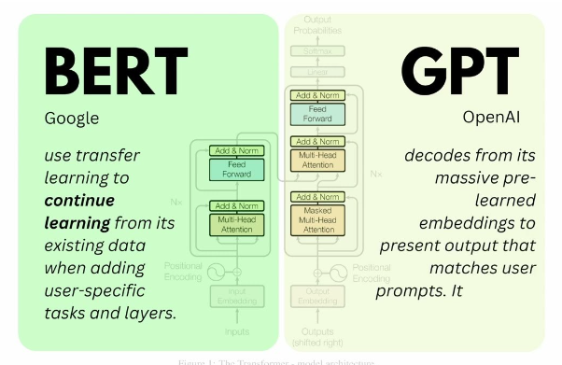
5. Improvement of Service and Future Plans
We will expand services to maintain continuity of public services.
Administrative services in everyday life
Expand the National Assistant Service
Operational reliability + institutional
referral + collaboration
Convenient and useful services!
The Virtual Assistant Service needs to scale up and grow
so that it can get closer to people’s lives.
National
Assistant
Service
Notifications
Inquiry
16 million members
Operating System
Services
Development Environment
Provide diverse services through public-private partnership
Used by more than 1 out of
3 people in Korea
More than 700 million notifications delivered
Ask chatbots for complaint information
People
(users)
Public
Services
Services
Services
Private Sector
Platform
Services
Need to expand more convenient and useful services
Service Identification
Notes:
마지막으로 국민비서의 발전방안 및 향후계획에 대해 말씀드리겠습니다.
Finally, I will talk about improvement of service and future plans for the National Secretary.
In order to provide administrative information for people’s everyday life, the Virtual Assistant Service needs to be scaled up with new services based on the stabilization of existing services to ensure public service continuity
또한, 현재 국민비서 상담 서비스는 생성형 ai 기술은 적용되지 않았기 때문에, gpt등의 생성형 ai도입도 신중히 검토 중입니다.
In addition, since the current National Secretary Consultation Service does not apply generative AI technology, the introduction of generative AI such as GPT is also being carefully considered.

Slide 25
5. Improvement of Service and Future Plans
We will continue to improve user satisfaction with the services.
Improve user satisfaction
Upgrade features and
stabilize operation
Identify core contents
“Upgrade” Virtual Assistant features and identify “hidden services”
for improved satisfaction!
Notes:
We will continue to further develop the National Assistant Service ecosystem by continuously identifying the needs of organizations and people using the National Assistant, increasing the identification of new services, providing convenience for users, upgrading its features and identifying new hidden services (core contents).

Slide 26








5. Improvement of Service and Future Plans
We will continue to improve people’s experience.
We will expand services, add private sector apps, and engage in public collaboration
We can improve user satisfaction
with the Virtual Assistant Service!
Continue to provide good services
connect users to notification services from more institutions in various ways.
Connected Services
We
(Dec. 31, 2023)
We can get
answers across
multiple areas!
We can ask questions
outside of
business hours!
67
services
45 services
53
institutions
19
institutions
We can solve simple
questions more quickly !
Private
sector apps
Notifications and notices
Inquiry
Linked
institutions
I didn’t know
they offered these services!
provide high quality administrative services by adding various knowledge bases.
High Quality
We
Expand knowledgebases
Inquiry Area 1
Inquiry Area 2
...
Inquiry area n
Process Simple, Repeated Questions
We
continue to scale services in preparation for growing service demand.
We
We
Reduce work load
Improve service quality
Notes:
We will continue to improve the quality of the National Secretariat Service to enhance people’s experience.
We will ensure that the “Good Service” GoodPy lives up to its reputation as the leading administrative service of the Republic of Korea.

Slide 27
Thank you.
Ministry of the Interior and Safety
Notes:
Thank you for listening.
--------------------- (Q&A) --------------------------

