Slide 1
AI in Public Sector Scan
A Scan of Some Recent Use Cases
Artificial Intelligence in the Public Sector:
Best Practices and Policy Considerations
Phnom Penh, Cambodia
05 December 2024
Philip McGrath
Governance Global Practice
World Bank
Supported by the GovTech Global Partnership: www.worldbank.org/govtech

Slide 2
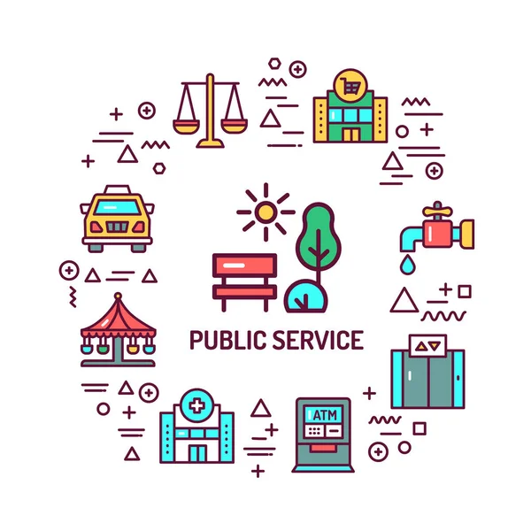
AI in Public Services compelling use cases
Healthcare
Justice and Rule of Law
Anti-Corruption

Slide 3
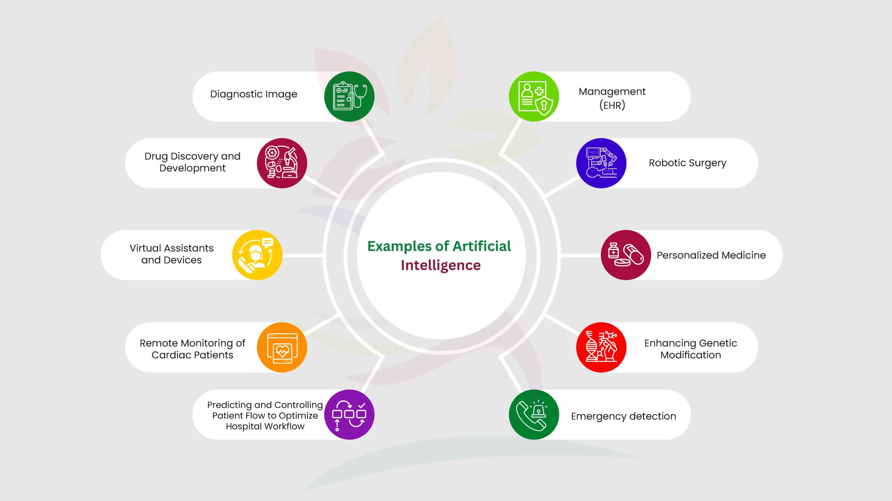
Artificial Intelligence: Why Governments Must Act Now
Healthcare

Slide 4
Application | AI Performance/Impact | Comparison to Traditional Methods | Outcome | Country
Prostate Cancer Detection | 84% accuracy using AI (Unfold AI) | 67% accuracy by human doctors | Enhanced diagnostic precision for early treatment | USA
Skin Cancer Detection | 95% accuracy with deep learning convolutional neural network | 86.6% accuracy by dermatologists | Improved detection rates of skin cancer | Germany, USA, France
Intracranial Hemorrhage Detection | Reporting time reduced from 132 to 73 minutes (45% decrease) | Traditional reporting workflows | Accelerated prioritization of critical cases | USA
Abdominal CT Scan Triage | 93% sensitivity, 97% specificity in detecting acute findings | Manual prioritization | Streamlined radiology workflow and expedited diagnostics | USA
Sepsis Diagnosis | Early detection and prediction of severe cases within 24 hours | Traditional clinical diagnosis | Reduced sepsis-related mortality | USA
Alzheimer’s Disease Prediction | 80% prediction accuracy, three times more accurate than clinical standards | Traditional methods | Earlier intervention opportunities for Alzheimer’s treatment | UK
Breast Cancer Detection | AI model achieved nearly 94% accuracy in detecting various cancer types | Performance varies among human experts | Improved diagnostic accuracy | USA
Colonoscopy Polyp Detection | AI system trained in Israel showed non-inferior performance applied in Japan | Performance consistent across different countries | Effective generalization of AI models | Israel, Japan

Slide 5
AI for Diagnostics and Better Patient Outcomes
Problem:
- Radiologists face high volumes of medical images, increasing risk of diagnostic errors and delays.
Solution:
- Aidoc (one provider) developed AI algorithms to assist in interpreting medical images (other providers include Kheiron Medical Technologies, Subtle Medical, and AIRS Medical).
- Focused on detecting conditions like intracranial hemorrhage and pulmonary embolism.
- Operates in the background, analyzing and flagging urgent findings for review.
Impact:
- Implemented in 900+ hospitals globally.
- Clinical studies show over 90% accuracy in detecting conditions.
- Improved diagnostic accuracy and expedited patient care.

Slide 6
AI for Hospital Capacity Management in Acute Settings
Problem:
- Manual bed allocation at Kettering General Hospital caused delays and suboptimal resource use.
- Challenges in managing patient flow and admissions.
Solution:
- Collaboration with National Health Service AI Lab to develop an AI-driven bed management tool.
- Tool predicts patient flow and provides bed allocation suggestions.
- Uses machine learning to analyze patterns in admissions, discharges, and occupancy.
Impact:
- Reduced patient wait times and optimized hospital resources.
- Improved operational efficiency and patient satisfaction.
- Demonstrated scalability across government healthcare services.

Slide 7
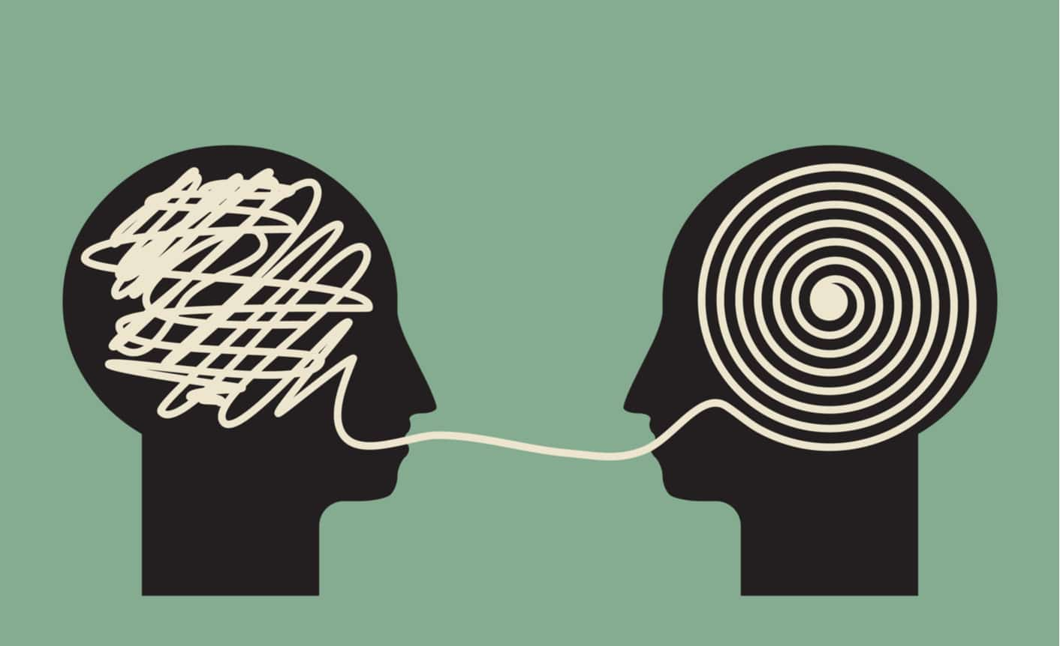
Justice and Rule of Law – Simplification of Rulings
AI simplifies complex legal rulings, making them more understandable for the public.
Example:
- Argentina: summarization and simplification of rulings using LLMs (see Gutiérrez, 2023)
Benefits:
- Improves public understanding of judicial decisions.
- Builds public trust in the judicial system (caution: easily broken).
Risks:
- Oversimplification of legal nuances.
- Dependence on AI without adequate human review.
Governance Needs:
- Standards for AI outputs and mandatory human verification.

Slide 8
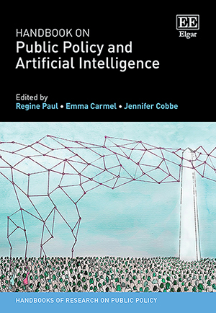
Justice and Rule of Law – Judicial Drafting
Problem Faced:
- Judicial congestion, inefficiencies, and delays in drafting rulings.
- Lack of digital literacy and guidelines complicates AI integration.
Technology Used:
- ChatGPT by OpenAI: Used by Judge García in 2023.
- Assisted in drafting 29% of a ruling on an autistic child’s medical rights.
Impacts:
- Efficiency: Reduced drafting time with structured outputs.
- Transparency: Explicit AI use in judgments.
- Accessibility: Simplified legal language for laypersons.
Risks and Issues:
- Accuracy: Prone to errors and biases.
- Automation Bias: Risks over-reliance on AI outputs.
- Ethical Challenges: Privacy and due process concerns.
- Opaque Development: Lack of transparency in AI training data.
Lessons and Recommendations:
- Establish guidelines for ethical AI use in judiciary.
- Provide digital literacy training for judges and clerks.
- Ensure human oversight in AI-assisted judicial decisions.

Slide 9
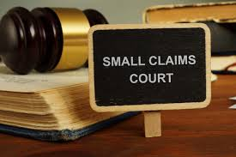
Low Risk Decision-Making
AI supports quick and efficient resolution of disputes through ODR platforms.
Examples:
- China: Hangzhou Internet Court uses AI to adjudicate internet-related cases (small claims etc.); now being rolled out to other courts including Beijing online court
- Singapore: Small Claims Tribunals use AI for e-negotiation and mediation.
Benefits:
- Reduces court backlogs and increases access to justice.
- Cost-effective resolution for minor disputes.
Risks:
- Limited access for individuals lacking digital literacy.
- Potential unfair outcomes in complex disputes.
Governance Needs:
- Ensuring inclusivity and regular audits for fairness and accuracy.

Slide 10
AI to Tackle Corruption
Brazil: AI Tackling Procurement Fraud
ALICE (Analyzer of Bids, Contracts, and Notices):
- Developed by Brazil’s Office of the Comptroller General.
- Analyzes procurement data for irregularities like overpricing and collusion.
- Flags high-risk contracts for review.
How?
- Fraudulent supplier bids for healthcare equipment identified.
- Outcome: Contracts canceled, funds redirected to public hospitals.
Impact:
Detected $133M in anomalies in its first year.
Reduced procurement fraud
- Strengthened citizen trust through the Transparency Portal.

Slide 11
Further Recent Use Cases of Value to Countries

Slide 12
Further Use Cases
Country | Description of Initiative | Impact for Citizens | Type of AI Employed
Netherlands | AI used in Nijmegen to count people in city center to monitor traffic and economic activity. | Improved road safety and entrepreneurial support. | Recognition and forecasting
Australia | Using machine learning and computer vision to classify land use features in satellite imagery. | Enhanced response to biosecurity and disaster events. | Machine learning, computer vision
Norway | Conversational AI (Frida) to assist citizens in accessing social benefits 24/7. | Faster and more reliable access to social benefits. | Conversational AI
Canada | Risk-assessment algorithm to identify high-risk cargo for inbound aircraft. | Increased safety in air cargo transport. | Risk assessment algorithm
Luxembourg | Facial recognition to identify public figures in political media library. | Streamlined access to tagged political media for reporting. | Facial recognition
Belgium | CitizenLab for grouping and categorizing citizen input from online platforms. | Better responsiveness to community needs. | Event detection
France | Generative AI tool 'Albert' for assisting public service advisors with customized solutions. | Improved efficiency and responsiveness of public service advisors. | Generative AI

Slide 13
Further Use CAses
Italy | Custom AI model GiusBERTo for de-identifying court decisions to protect privacy. | Balanced privacy protection and access to court information. | Custom AI model
Colombia | AI combined with satellite imaging for detailed geo-cadastral information in rural areas. | Improved property recognition and registry in remote areas. | Satellite imaging and recognition
Finland | AuroraAI program to identify and simplify cumbersome public services. | Proactively offered services based on life events. | Recognition and personalization
Austria | Conversational chatbot Mona to assist entrepreneurs with business services. | Enhanced access to information and reduced workload for civil servants. | Conversational chatbot
Turkey | AI-powered 'Neyim Var?' application in e-health for personalized health recommendations. | Better health outcomes through tailored health advice. | Personalization AI
Spain | AI to identify fraud in grant and subsidies programs. | Reduced fraud in public spending. | Event detection
Estonia | Core components for AI service development, including virtual assistants and translation tools. | Improved accessibility and efficiency of public services. | Various tools (virtual assistant, text analysis)
1. Executive Summary and Introduction
2. Digital Transformation: The Foundation for AI in the Public Sector
3. A Framework for AI in the Public Sector – the Principles and the Practices
4. Practical Steps for Overcoming Challenges
5. Recommendations for Successful AI Implementation
Annex: Maturity Model

Slide 14
Resources Available:
1. Global Partnership on AI: gpai.ai
2. European Commission’s TechWatch Database (>1,000 AI use cases from European Countries, searchable, https://interoperable-europe.ec.europa.eu/collection/public-sector-tech-watch
3. Coming Soon: The World Bank’s AI Case Study Repository

Slide 15
What are your AI examples?
What are you planning, creating or proud of that others would be interested in?

Slide 16
Thank you!
November 9, 2021
www.worldbank.org/govtech

